Slide 1




The Internet
Year 4 · Computing systems and networks
Our whole unit in one adventure!

Slide 2






Our adventure: 6 lessons
1 Connecting networks
2 What is it made of?
3 Sharing information
Networks join up to make the internet
Switches, servers, routers and the web
Web addresses and where websites live
4 What is a website?
5 Who owns the web?
6 Can I believe it?
The parts of a website and making content
Content belongs to people
Real or fake? Think before you share
Notes:
Use this slide to introduce the unit. Each lesson below has a section slide, key words, pictures, quick quizzes and an activity.

Slide 3
LESSON 1
Connecting networks
How do networks join to make the internet?
Notes:
Lesson 1: Connecting networks

Slide 4

Today I can…
I can describe the internet as a network of networks
I can show how information is shared across the internet
I can explain why a network needs protecting
Notes:
Read the objectives together. At the end of the lesson, come back to this slide and ask pupils to show thumbs up, sideways or down for each one.

Slide 5



Think · Pair · Share
What do you already know about the word “INTERNET”?
Think
Pair
Share
Notes:
Record pupils’ ideas on a flipchart. You will come back to them at the end of the lesson.

Slide 6

Key words
Network
Router
Computers and devices joined together so they can share information
A device that sends messages from one network to another
Internet
Network security
A network of networks all over the world
Keeping a network safe so only the right messages get in

Slide 7
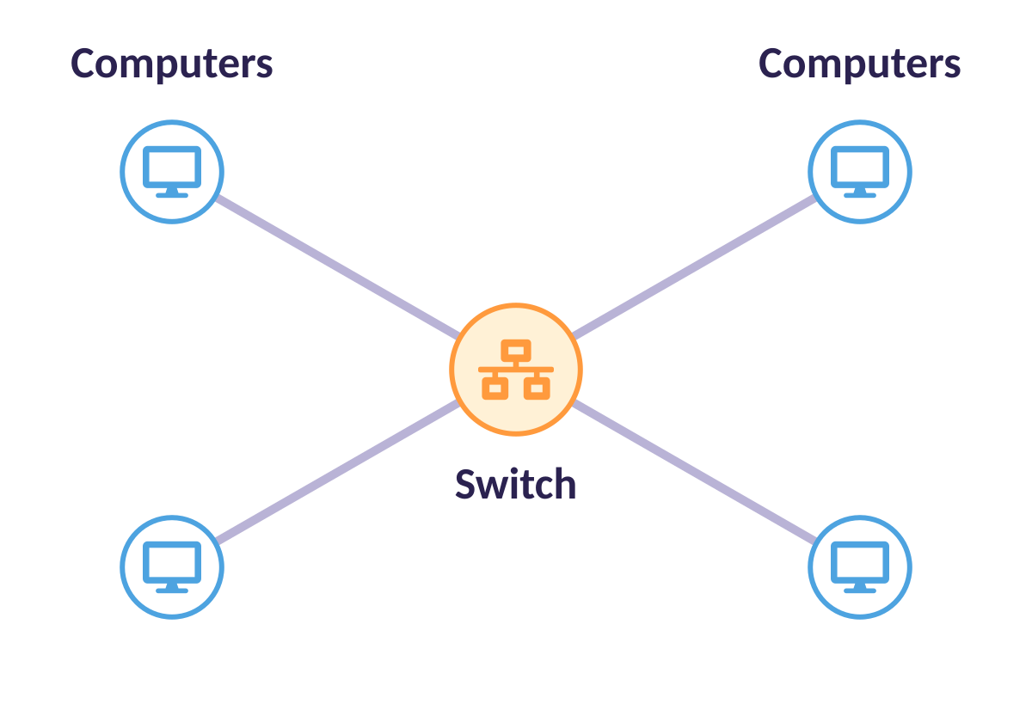
Inside one network
Computers are connected to a switch.
The switch passes messages round the network.
A switch only needs the address of the person you are sending to.

Slide 8
Activity: Be the network!
ACTIVITY
Sit in groups of six. Each group is a place: home, hospital or shop.
1
Number yourselves 1 to 5. One person is the switch.
2
Write a message. Add your address, like 2@hospital.
3
Pass your message to the switch. The switch delivers it!
4
Notes:
Groups of six. Use the A1 handout message cards. Each table only gets cards for its own location. Swap if a pupil receives their own card.

Slide 9
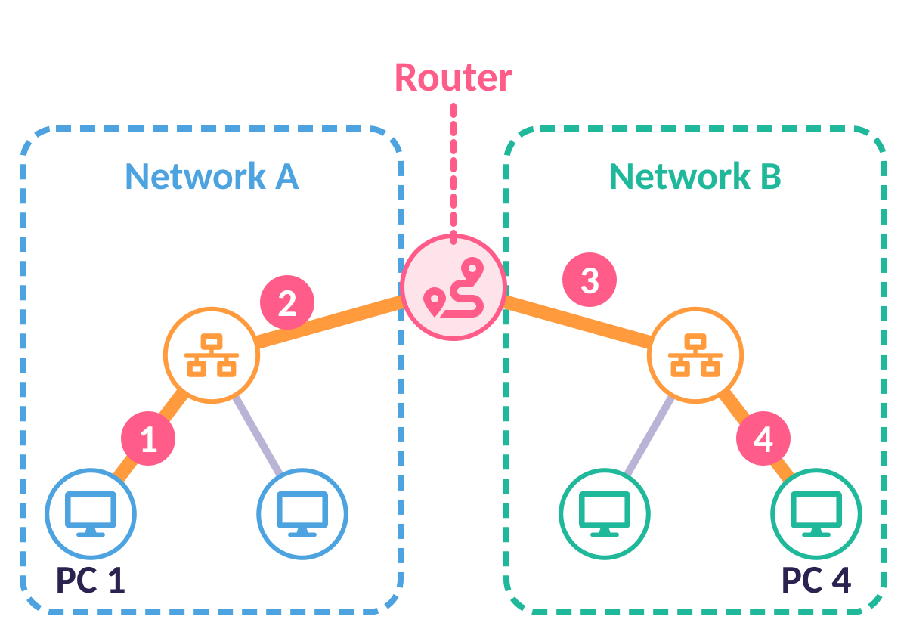
Messages between networks
To reach another network you need a router.
1 PC 1 sends to the switch in network A.
2 The switch sends to the router.
3 The router sends to the switch in network B.
4 That switch delivers to PC 4.

Slide 10
Activity: Be the router!
ACTIVITY
One pupil from each table is a router.
1
Pass your message to your switch.
2
The switch gives it to a router.
3
The router carries it to the right table’s switch.
4
Notes:
Start with one router, then use three routers. Change who plays the switch from the first activity.

Slide 11
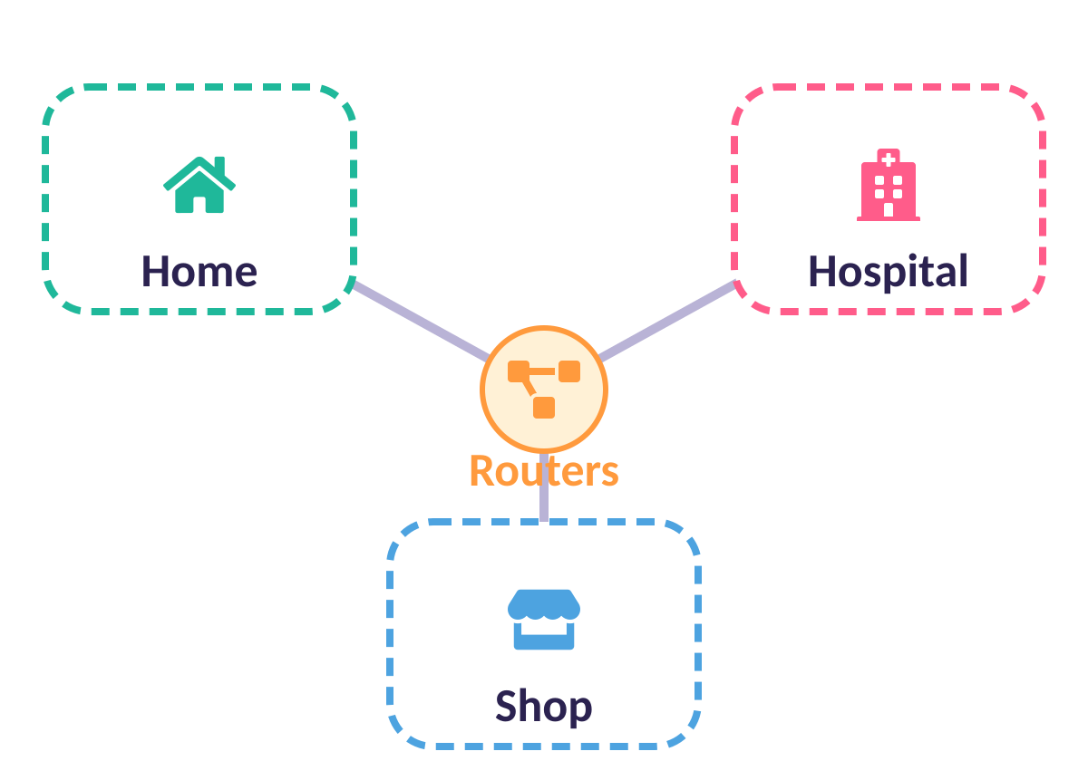
A network of networks
Many networks joined by routers make a much bigger network. On the real internet a message passes through lots of routers.

Slide 12
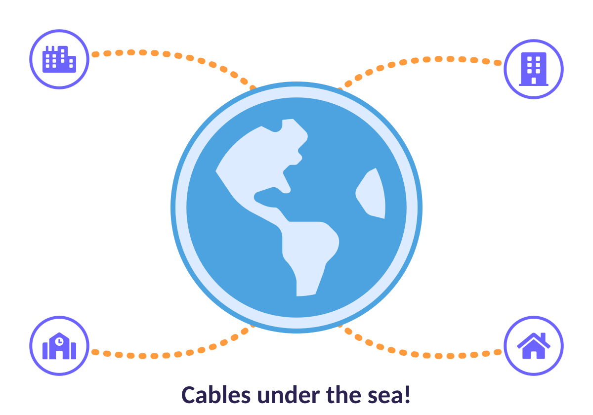
Networks in different countries
Cables join networks together on land and under the sea. Why do you think there are SO many cables?
Notes:
See submarinecablemap.com. Pupils may suggest: lots of people use the internet; messages need a route; if one cable breaks another can be used.

Slide 13
Quick quiz
What is the internet?
One big computer in America
A
A network of networks joined together
B
A website for watching videos
C
Notes:
Pupils vote with fingers (1, 2, 3) or on mini whiteboards before the answer slide.

Slide 14
✔ The answer
What is the internet?
One big computer in America
A
A network of networks joined together
B
A website for watching videos
C
The internet is a global network of networks!
Notes:
Pupils vote with fingers (1, 2, 3) or on mini whiteboards before the answer slide.

Slide 15
Quick quiz
What does a router do?
Sends messages from one network to another
A
Stores your homework
B
Makes the screen brighter
C
Notes:
Pupils vote with fingers (1, 2, 3) or on mini whiteboards before the answer slide.

Slide 16
✔ The answer
What does a router do?
Sends messages from one network to another
A
Stores your homework
B
Makes the screen brighter
C
A router routes messages between networks.
Notes:
Pupils vote with fingers (1, 2, 3) or on mini whiteboards before the answer slide.

Slide 17
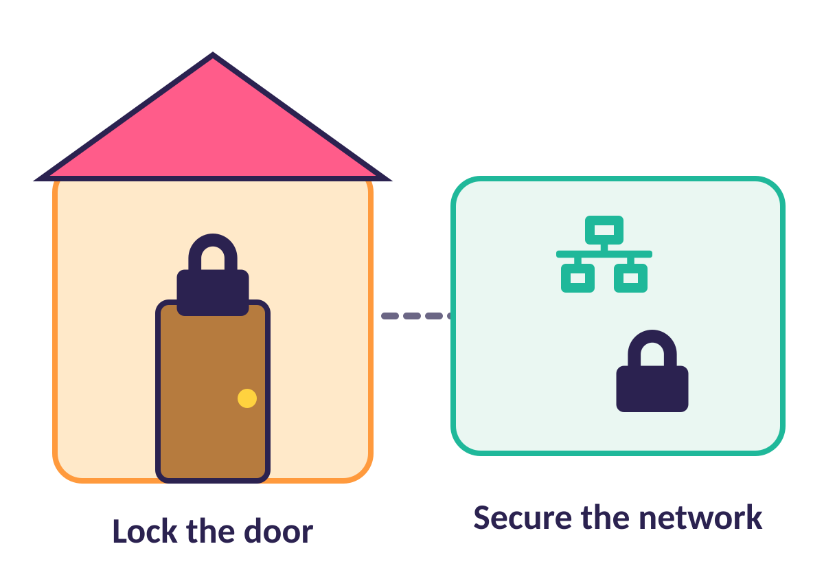
Keeping networks safe
A front door has a lock so only people with a key can come in.
A network needs security too.
Some information is private.
Some information can be harmful, like a computer virus.

Slide 18






Accept or block?
Message from a friend: “Come to my party!”
Hospital patient records sent to a shop
An email with a virus attachment
School newsletter for parents
Someone asking for your password
Your teacher’s homework message
Decide: ACCEPT ✔ or BLOCK ✖?
Notes:
Pupils act as routers and decide whether to let each message through. Discuss: private, not relevant, or harmful.

Slide 19
✔ Accept or block? — answers
Message from a friend: “Come to my party!”
Hospital patient records sent to a shop
An email with a virus attachment
ACCEPT ✔
BLOCK ✖
BLOCK ✖
School newsletter for parents
Someone asking for your password
Your teacher’s homework message
ACCEPT ✔
BLOCK ✖
ACCEPT ✔
Notes:
Pupils act as routers and decide whether to let each message through. Discuss: private, not relevant, or harmful.

Slide 20
Think · Pair · Share
Now: what IS the internet? Improve your first idea!
Think
Pair
Share
Notes:
The internet is a global network of networks.

Slide 21
LESSON 2
What is the internet made of?
What parts join up to make the internet?
Notes:
Lesson 2: What is the internet made of?

Slide 22



Today I can…
I can describe networked devices and how they connect
I can explain the internet provides many services
I can say the World Wide Web is part of the internet
Notes:
Read the objectives together. At the end of the lesson, come back to this slide and ask pupils to show thumbs up, sideways or down for each one.

Slide 23
Key words
Network switch
Server
Connects lots of devices on a network to each other
A computer that stores files and looks after the network
Wireless access point
Router
Sends and receives Wi-Fi signals for the network
Passes information between two networks

Slide 24
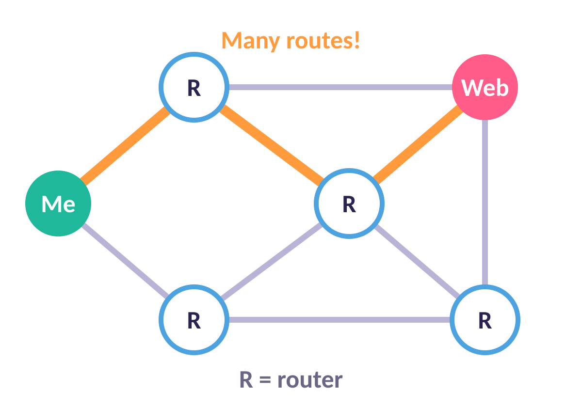
Finding routes
Messages can take many routes to get from you to the web. If one route is blocked they can use another!
Notes:
Use the A1 Finding routes worksheet. Discuss the shortest route and what happens if a router breaks.

Slide 25
Activity: Finding routes
ACTIVITY
Look at the map of routers.
1
Find the shortest route from Me to Web.
2
Find a different route in case one is broken.
3
Count how many routers each route uses.
4
Notes:
Pupils complete A1 Finding routes. Peer-mark.

Slide 26
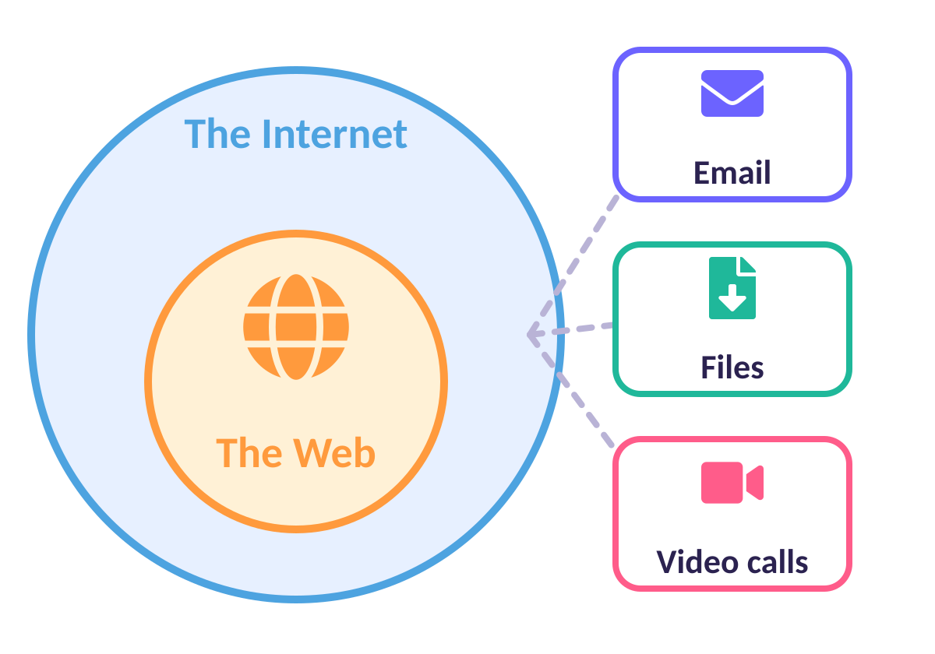
The internet gives us services
The internet delivers MANY services. The World Wide Web is just ONE of them!
Notes:
Misconception check: the internet and the World Wide Web are NOT the same thing. The web is part of the internet. WWW = World Wide Web.

Slide 27
Quick quiz
Which is correct?
The World Wide Web is part of the internet
A
The internet is part of the World Wide Web
B
They are exactly the same thing
C
Notes:
Pupils vote with fingers (1, 2, 3) or on mini whiteboards before the answer slide.

Slide 28
✔ The answer
Which is correct?
The World Wide Web is part of the internet
A
The internet is part of the World Wide Web
B
They are exactly the same thing
C
The web is one service on the internet.
Notes:
Pupils vote with fingers (1, 2, 3) or on mini whiteboards before the answer slide.

Slide 29
Activity: Explore the web
ACTIVITY
Visit the three websites your teacher gives you.
1
For each one, write 3 things you can SEE, HEAR or DO.
2
Is there a video? A picture? A game?
3
Which website would you visit again? Why?
4
Notes:
Websites: bbc.co.uk/newsround and horrible-histories.co.uk plus your school website. Provide prompts for support: can you find a video, a picture, some text?

Slide 30
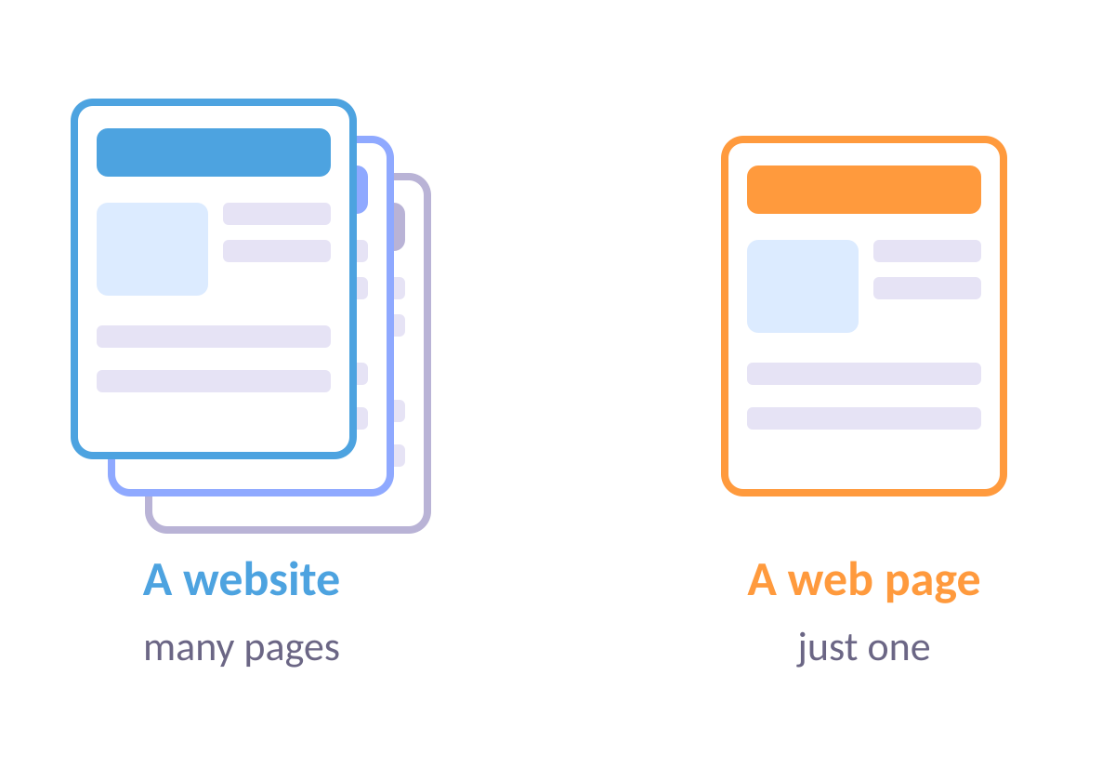
Website or web page?
A website is a collection of web pages under one name. A web page is a single page.
Notes:
Let pupils revisit the two examples to spot the difference.

Slide 31
Quick quiz
A website is…
One single page
A
A collection of web pages under one name
B
A type of router
C
Notes:
Pupils vote with fingers (1, 2, 3) or on mini whiteboards before the answer slide.

Slide 32
✔ The answer
A website is…
One single page
A
A collection of web pages under one name
B
A type of router
C
A web page is one page. A website has many!
Notes:
Pupils vote with fingers (1, 2, 3) or on mini whiteboards before the answer slide.

Slide 33



Think · Pair · Share
Complete the sentence: “The World Wide Web is part of the ______ and contains ______.”
Think
Pair
Share
Notes:
Answer: internet; websites and web pages.

Slide 34
LESSON 3
Sharing information
What can we share on the web, and where does it live?
Notes:
Lesson 3: Sharing information

Slide 35


Today I can…
I can explain what types of media can be shared on the web
I can say where websites are stored
I can describe how to get to websites
Notes:
Read the objectives together. At the end of the lesson, come back to this slide and ask pupils to show thumbs up, sideways or down for each one.

Slide 36



Key words
Web address
Web browser
The name you type to find a website
A program for looking at websites, like Chrome
Routing
Web page
Finding a path for information to travel
A single page on the World Wide Web

Slide 37






Can we share it on the web?
A photo of your pet
A real sandwich
A song
A real dog
A video clip
A paper book (an e-book CAN be shared!)
Decide: YES ✔ or NO ✖?
Notes:
Physical objects cannot be shared. Photos, videos, sounds and text can. A paper book cannot, but an electronic book can.

Slide 38
✔ Can we share it on the web? — answers
A photo of your pet
A real sandwich
A song
YES ✔
NO ✖
YES ✔
A real dog
A video clip
A paper book (an e-book CAN be shared!)
NO ✖
YES ✔
NO ✖
Notes:
Physical objects cannot be shared. Photos, videos, sounds and text can. A paper book cannot, but an electronic book can.

Slide 39
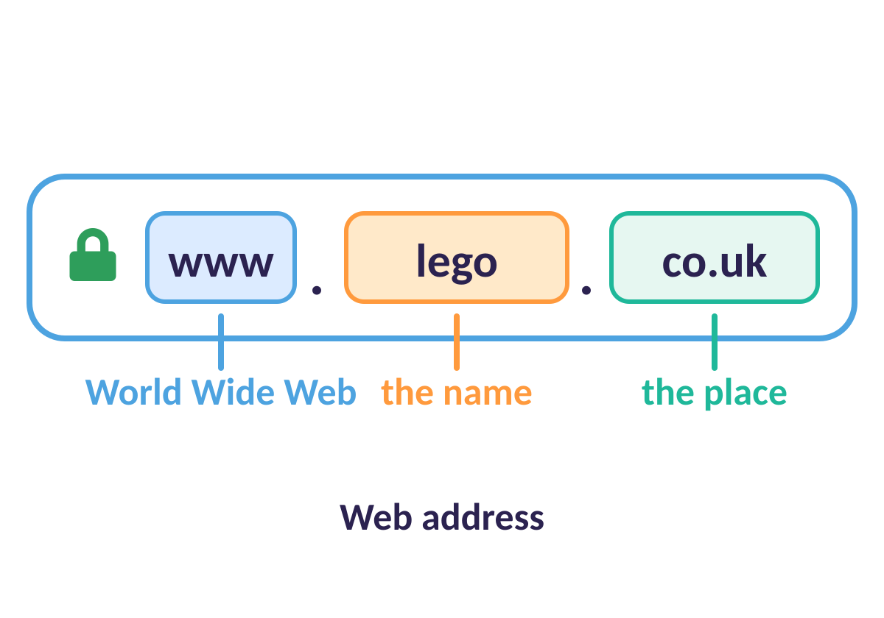
What’s in a name?
www = World Wide Web. The middle is the name of the site or group. The end shows the place or type: .com, .edu, .co.uk, .fr
Notes:
Let pupils guess where sites come from. .co.uk = UK, .fr = France.

Slide 40




Web address endings
.co.uk
.fr
A website from the United Kingdom
A website from France
.edu
.com
A school or college
Often a company
Notes:
Ask pupils to look for clues. Check: which domain would a French school use?

Slide 41
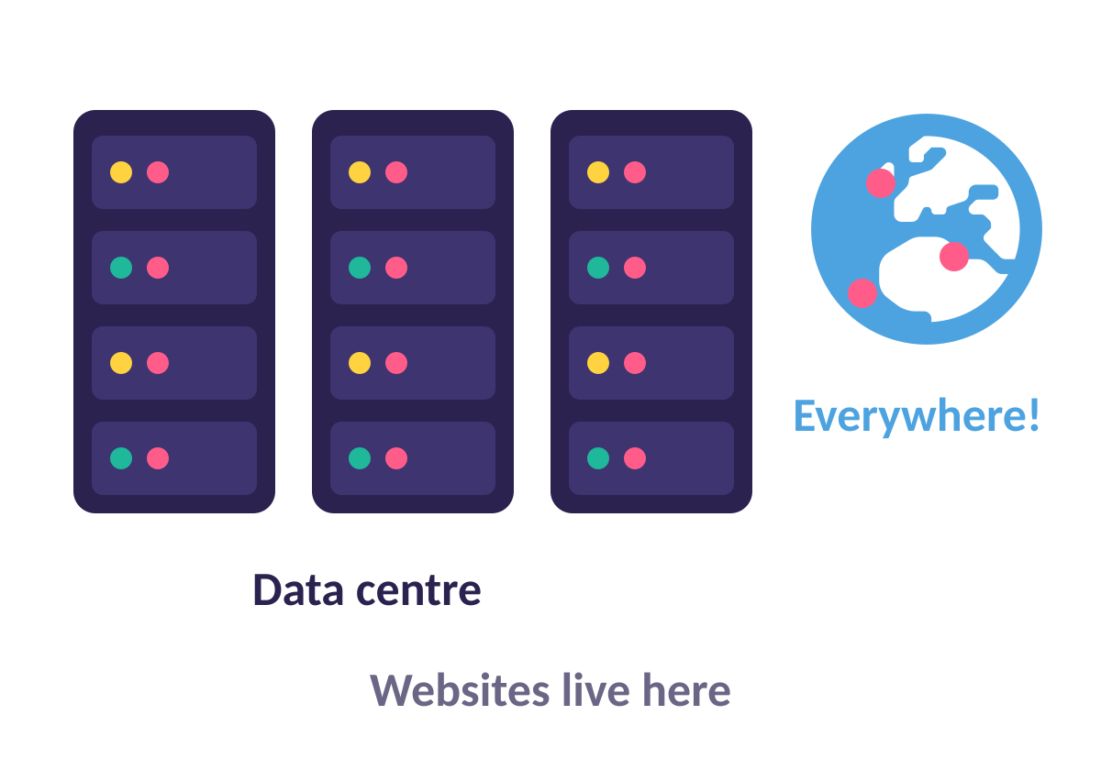
Where do websites live?
Websites are stored in big data centres. They are all around the world. Some belong to Google, Amazon, Apple and Microsoft.
Notes:
See Google’s data-centre map on slide 15 of the original L3 slides.

Slide 42
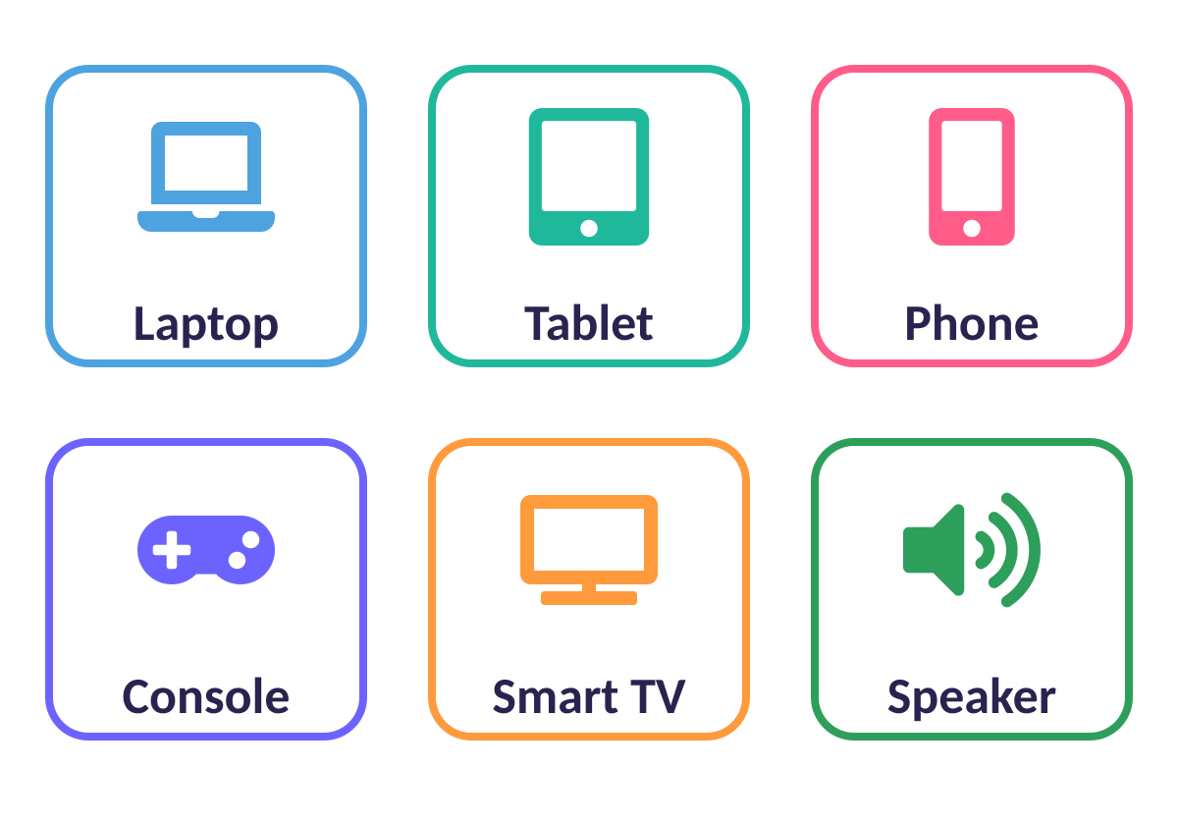
Devices that reach the web
Lots of devices can connect to the web. What do they ALL need? A web browser!
Notes:
Pupils make a mind map on A3 sheet. Misconception: Google is a search engine; Chrome is the browser.

Slide 43
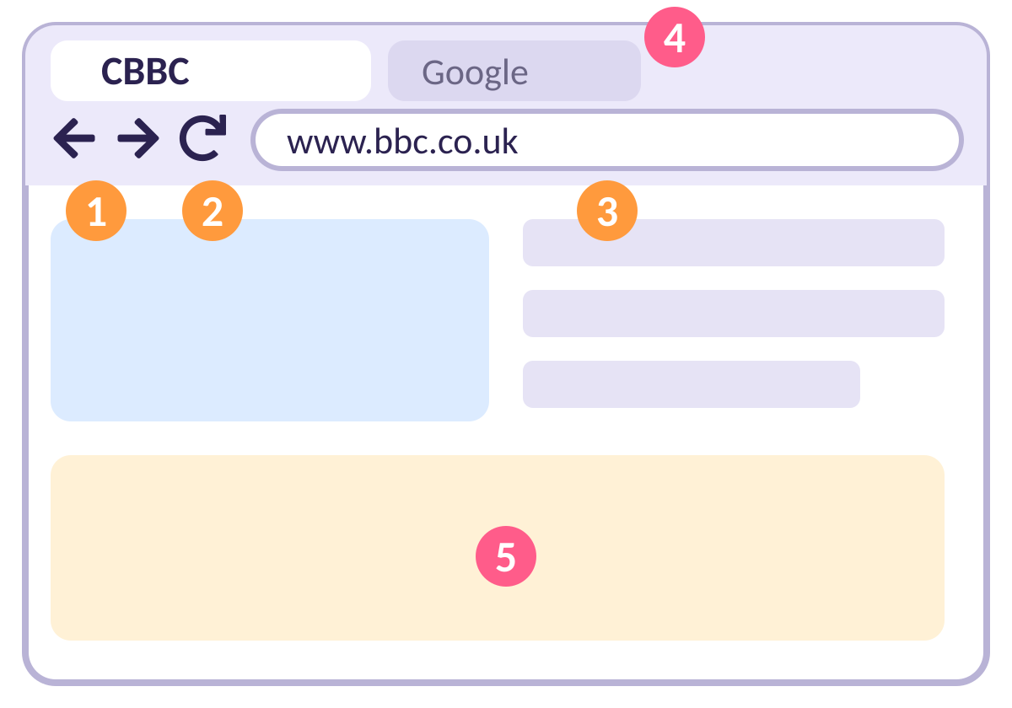
Parts of a web browser
1 Back and forward
2 Refresh
3 Address bar
4 Tabs
5 Main view
Notes:
Which browsers have you used? Chrome, Safari, Edge, Firefox, Opera.

Slide 44
Quick quiz
Which of these is a web browser?
Facebook
A
Google
B
Chrome
C
Notes:
Pupils vote with fingers (1, 2, 3) or on mini whiteboards before the answer slide.

Slide 45
✔ The answer
Which of these is a web browser?
Facebook
A
Google
B
Chrome
C
Chrome is a browser. Google is a search engine.
Notes:
Pupils vote with fingers (1, 2, 3) or on mini whiteboards before the answer slide.

Slide 46
Quick quiz
What is a router?
A device that directs information around the internet
A
A place where websites are stored
B
A device used for viewing websites
C
Notes:
Pupils vote with fingers (1, 2, 3) or on mini whiteboards before the answer slide.

Slide 47
✔ The answer
What is a router?
A device that directs information around the internet
A
A place where websites are stored
B
A device used for viewing websites
C
Routers direct information around the internet.
Notes:
Pupils vote with fingers (1, 2, 3) or on mini whiteboards before the answer slide.

Slide 48
LESSON 4
What is a website?
What is on a website, and can I add my own content?
Notes:
Lesson 4: What is a website?

Slide 49


Today I can…
I can explain what media can be found on websites
I can recognise that I can add content to the web
I can use a web service to create my own content
Notes:
Read the objectives together. At the end of the lesson, come back to this slide and ask pupils to show thumbs up, sideways or down for each one.

Slide 50

Key words
Content
Links
Things on a website: text, pictures, videos, sounds
Click them to go to another page or website
Files
World Wide Web
Things like documents, pictures or music you can save
All the websites and web pages connected on the internet

Slide 51
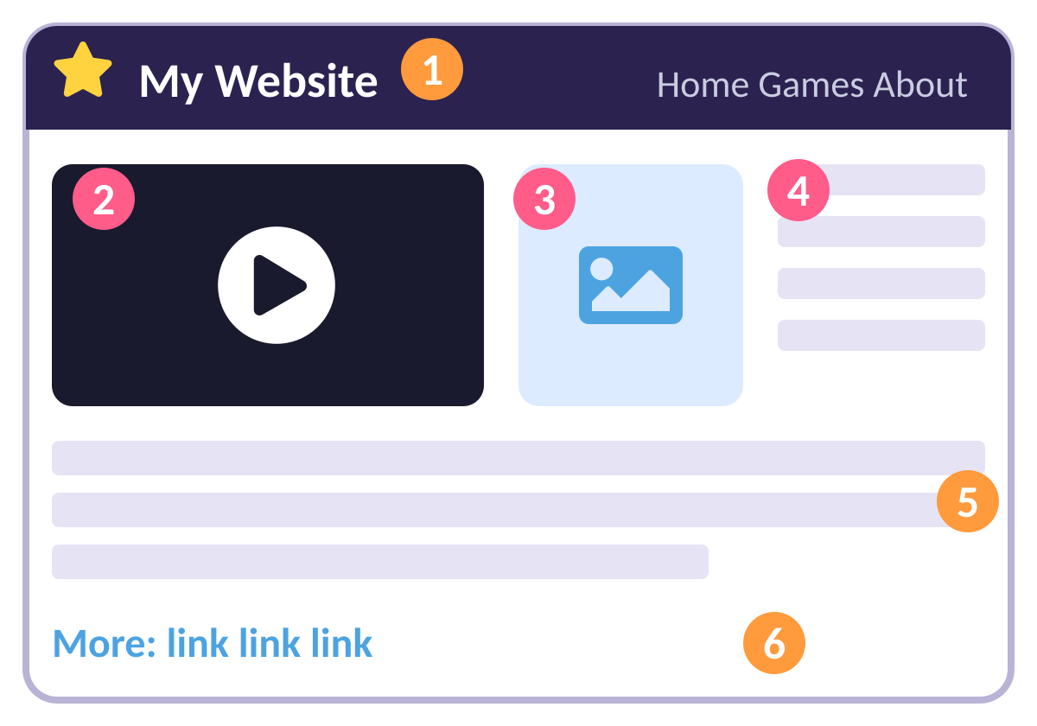
The features of a website
1 Logo or title
2 A video
3 A picture
4 Text
5 Links to other pages
6 More links
Notes:
Use the CBBC site or a topic site that has lots of media types. Pupils write the content they can see on whiteboards.

Slide 52
Activity: Be a website detective
ACTIVITY
Open the website your teacher chooses.
1
Find: a logo, a link, a video, a picture and some text.
2
Write the 5 things on your sheet.
3
Count how many links you can find!
4
Notes:
A1 Features of a website activity sheet. Resource: BBC CBBC bring and buy sale page, or any media-rich site.

Slide 53


Anyone can add content!
Good things
Not so good
Easy to add content · Shares knowledge · The web is for everyone
Not everything is true · Quality is different · Anyone can post
Notes:
Discuss advantages and disadvantages. The school website has content added by teachers, administrators and pupils.

Slide 54
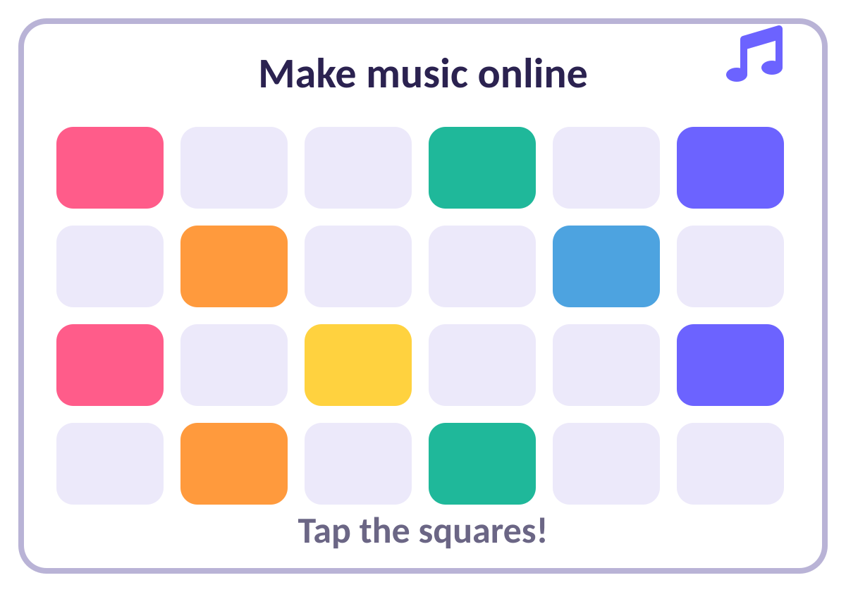
Make your own web content
Web tools let YOU create. Try Chrome Music Lab: open Kandinsky, draw and listen!
Notes:
Other creating tools: Scratch, Paintz.app, Google or Office 365 tools.

Slide 55
Activity: Create on the web
ACTIVITY
Go to Chrome Music Lab.
1
Open Kandinsky and draw lines and shapes.
2
Listen to the sounds you make!
3
Tell a partner: what did you create?
4
Notes:
Give pupils time to experiment. Point out that they used a tool on the World Wide Web to create their own content.

Slide 56
Quick quiz
Which can you ADD yourself on a website like Scratch?
Comments and projects
A
The website’s main menu
B
The company logo
C
Notes:
Pupils vote with fingers (1, 2, 3) or on mini whiteboards before the answer slide.

Slide 57
✔ The answer
Which can you ADD yourself on a website like Scratch?
Comments and projects
A
The website’s main menu
B
The company logo
C
You can add comments and remix projects, but not edit the page.
Notes:
Pupils vote with fingers (1, 2, 3) or on mini whiteboards before the answer slide.

Slide 58



Think · Pair · Share
Who made the content on a Scratch project page? Which parts can YOU change?
Think
Pair
Share
Notes:
Designers made the top and bottom links. Users made the project, notes and credits, and comments. You can comment or remix.

Slide 59
LESSON 5
Who owns the web?
Who owns the pictures, videos and words on websites?
Notes:
Lesson 5: Who owns the web?

Slide 60



Today I can…
I can explain that websites and their content are made by people
I can suggest who owns content on a website
I can explain there are rules to protect content
Notes:
Read the objectives together. At the end of the lesson, come back to this slide and ask pupils to show thumbs up, sideways or down for each one.

Slide 61



Key words
Ownership
Permission
Something belongs to someone
Saying yes so someone can use your work
Download
Sharing
Save a file from the internet to your device
Letting other people see or use something

Slide 62
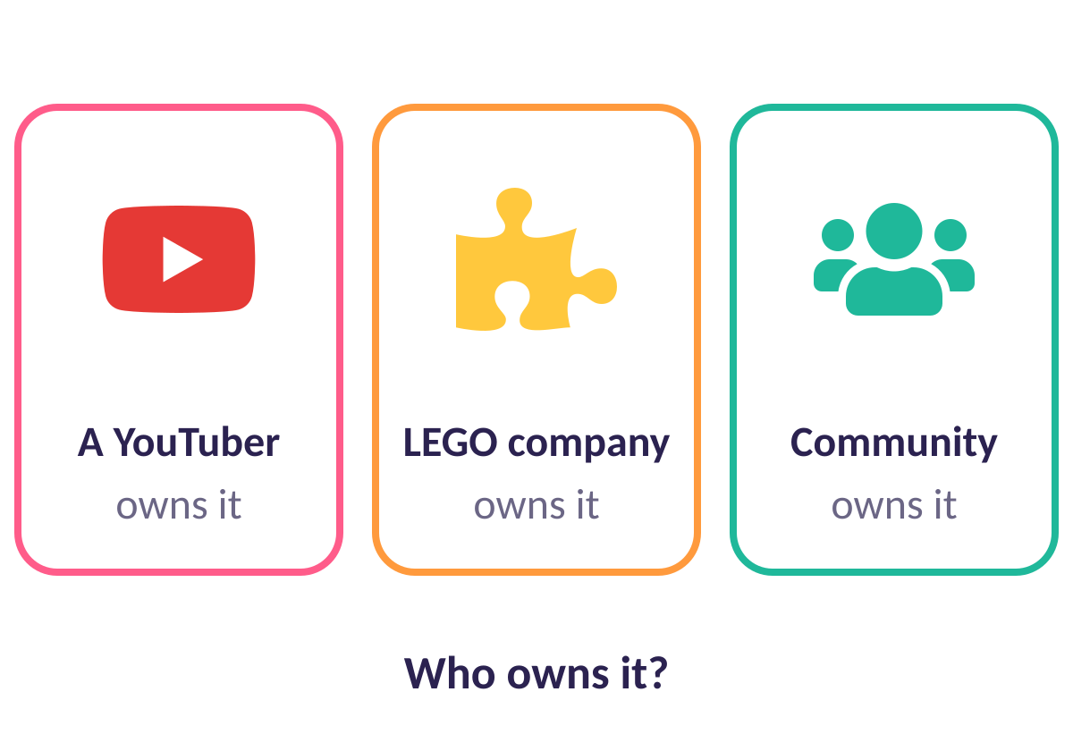
Who made it?
A person, a company or a community can all make content. They are the OWNERS.
Notes:
Websites used in the lesson: Dan TDM YouTube channel, LEGO website, Scratch.

Slide 63


Who does this belong to?
YouTube channel
LEGO website
Scratch
View ✔ Download ✖ Use as mine ✖
View ✔ Download some ✔ Claim as mine ✖
View ✔ Download ✔ Remix ✔ (give credit!)
Notes:
Answers from A1 Solutions. YouTube content belongs to the creator even though it is on YouTube. LEGO instructions can be downloaded but not changed or claimed. Scratch allows remixing with credit.

Slide 64
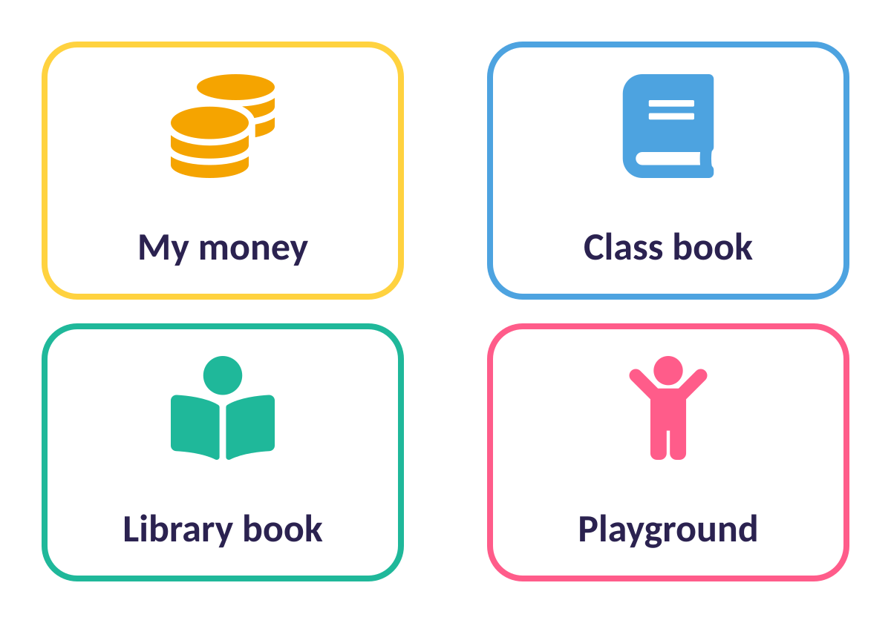
Sharing in real life
Things in real life have owners too. Who owns each? Who can use it? How should we share it?
Notes:
A2 Sharing things activity. Groups of 2 or 4.

Slide 65
Activity: Sharing rules
ACTIVITY
Pick one thing: your money, a classroom book, a library book or the playground.
1
Who owns it?
2
Who can use it?
3
How should we share it fairly?
4
Notes:
Groups share their ideas with the class.

Slide 66


Clues to who owns a web page
Who wrote it?
Copyright notice
Pictures from others
Look under the title for the author’s name
Look at the bottom of the page for who owns it
Credits show who gave permission, like NASA
Notes:
BBC News article on slide 15: written by Paul Rincon, owned by the BBC, with images from NASA used with permission.

Slide 67
Quick quiz
You find a picture online. What should you do before using it?
Use it and say it is yours
A
Check who owns it and ask permission
B
Delete the website
C
Notes:
Pupils vote with fingers (1, 2, 3) or on mini whiteboards before the answer slide.

Slide 68
✔ The answer
You find a picture online. What should you do before using it?
Use it and say it is yours
A
Check who owns it and ask permission
B
Delete the website
C
Always check the owner and ask permission or give credit.
Notes:
Pupils vote with fingers (1, 2, 3) or on mini whiteboards before the answer slide.

Slide 69






Before you share an image
Who made it?
Who owns it now?
Did they say yes?
Should I give credit?
Who will see it?
Is it kind and appropriate?
Notes:
Open discussion with the class.

Slide 70
LESSON 6
Can I believe what I read?
Is everything online true?
Notes:
Lesson 6: Can I believe what I read?

Slide 71



Today I can…
I can explain that not everything on the web is true
I can explain why some information may not be honest or accurate
I can explain why I must think before I share
Notes:
Read the objectives together. At the end of the lesson, come back to this slide and ask pupils to show thumbs up, sideways or down for each one.

Slide 72

Key words
Accurate
Honest
Correct and true
Telling the truth
Adverts
Sharing
Messages that try to make you buy things
Sending content on to other people

Slide 73
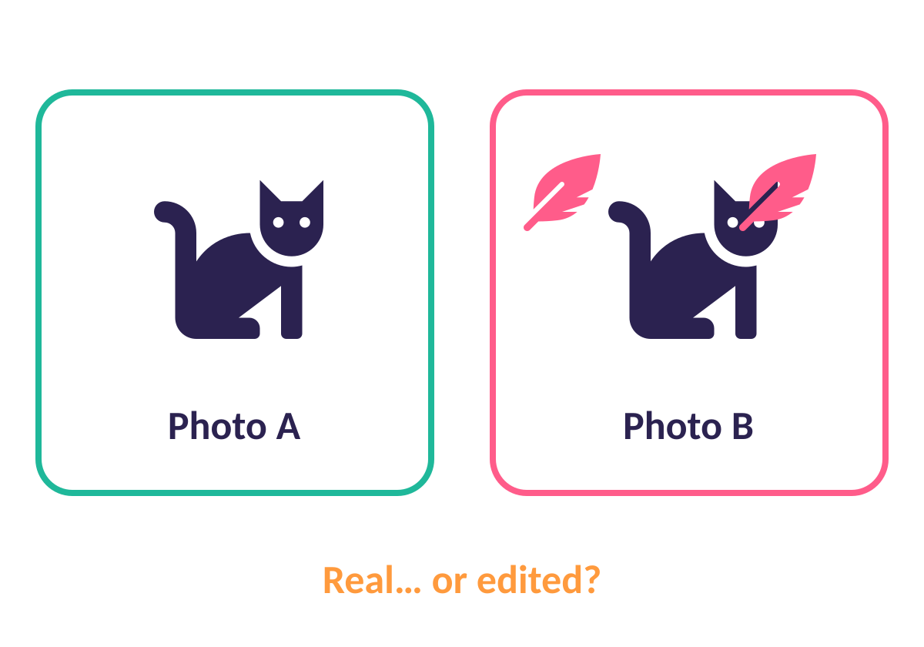
Is it real?
Pictures can be edited to look real. Which of these is real and which is edited? How could you tell?
Notes:
Show the three pixabay images from the lesson plan. Then vote: Can we believe everything we see or hear on the web?

Slide 74
Quick quiz
Can we believe EVERYTHING we see on the web?
Yes, always
A
No, we must check
B
Only on Fridays
C
Notes:
Pupils vote with fingers (1, 2, 3) or on mini whiteboards before the answer slide.

Slide 75
✔ The answer
Can we believe EVERYTHING we see on the web?
Yes, always
A
No, we must check
B
Only on Fridays
C
Not everything online is true!
Notes:
Pupils vote with fingers (1, 2, 3) or on mini whiteboards before the answer slide.

Slide 76
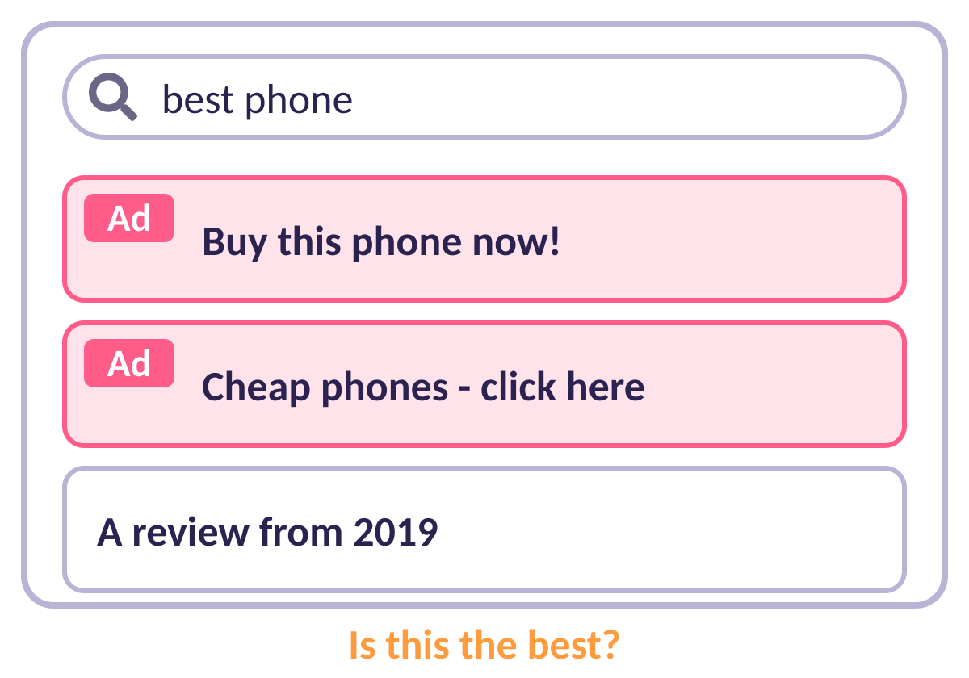
Is this the best?
Search “best phone”. Some results are ADVERTS. Some are old. Different people have different opinions!
Notes:
Reasons results can mislead: subjective question; sponsored results or ads; out-of-date information.

Slide 77




Why do people share false things?
To make money
To be popular
Fake reviews or claims to sell things
More likes and shares
To gain power
By mistake
To win votes
They did not know it was false
Notes:
Think–pair–share, then record answers on whiteboards. “Fake news” is also used for news that is true but disliked.

Slide 78
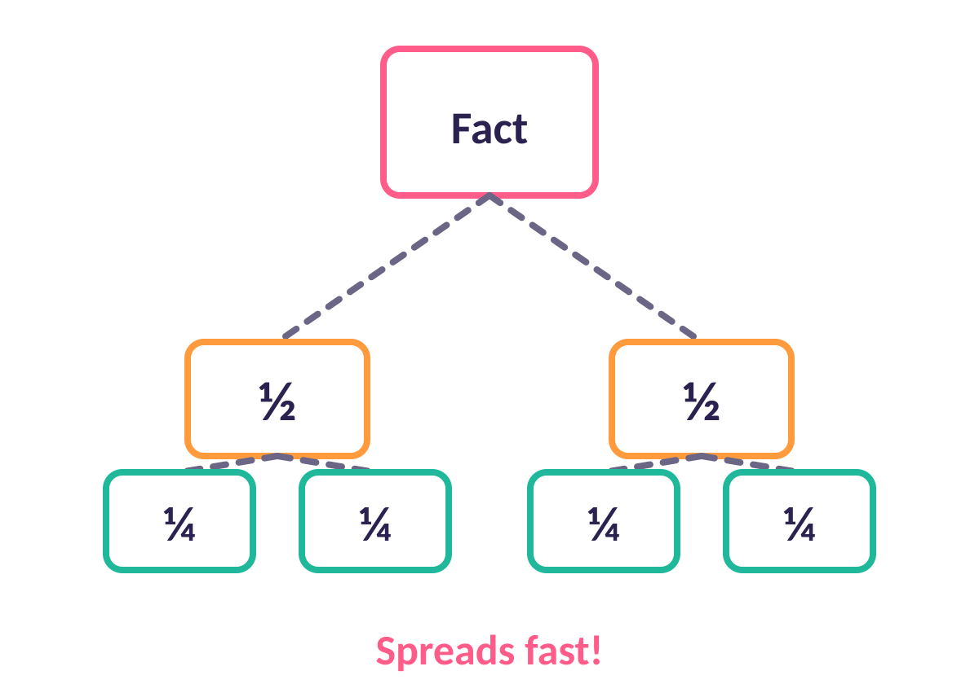
Activity: How does information spread?
ACTIVITY
Half the class writes a TRUE fact in each box. Half write a FALSE fact.
1
Cut your sheet in half and pass both pieces on.
2
Cut again and pass on. Do it three times: 8 pieces each!
3
Try to find all your pieces. Is it easy?
4
Notes:
A3 Activity sheet. Use coloured pencils for true and false. Point out that once information is shared, it cannot be un-shared. False news is 70% more likely to be retweeted than true stories (MIT study, 2018).

Slide 79
Quick quiz
Before you share something online you should…
Think: is it true and kind?
A
Share it quickly before anyone else
B
Share it with everyone you know
C
Notes:
Pupils vote with fingers (1, 2, 3) or on mini whiteboards before the answer slide.

Slide 80
✔ The answer
Before you share something online you should…
Think: is it true and kind?
A
Share it quickly before anyone else
B
Share it with everyone you know
C
Think before you share!
Notes:
Pupils vote with fingers (1, 2, 3) or on mini whiteboards before the answer slide.

Slide 81

My sharing checklist
Is it true?
Who made it?
Is it kind?
Can I check it somewhere else?
Do I trust them?
Could it hurt someone?
Notes:
Pupils choose three things to consider before sharing information.

Slide 82

FINAL CHALLENGE
Unit review
Show what you know!
Notes:
Lesson ★: Unit review

Slide 83
Quick quiz
The internet is…
A network of networks
A
One giant computer
B
A kind of website
C
Notes:
Pupils vote with fingers (1, 2, 3) or on mini whiteboards before the answer slide.

Slide 84
✔ The answer
The internet is…
A network of networks
A
One giant computer
B
A kind of website
C
A global network of networks.
Notes:
Pupils vote with fingers (1, 2, 3) or on mini whiteboards before the answer slide.

Slide 85
Quick quiz
Which device sends information between networks?
Router
A
Mouse
B
Printer
C
Notes:
Pupils vote with fingers (1, 2, 3) or on mini whiteboards before the answer slide.

Slide 86
✔ The answer
Which device sends information between networks?
Router
A
Mouse
B
Printer
C
A router passes information between networks.
Notes:
Pupils vote with fingers (1, 2, 3) or on mini whiteboards before the answer slide.

Slide 87
Quick quiz
In www.lego.co.uk, what does “.co.uk” tell us?
The website is from the UK
A
It is a game
B
It is about LEGO
C
Notes:
Pupils vote with fingers (1, 2, 3) or on mini whiteboards before the answer slide.

Slide 88
✔ The answer
In www.lego.co.uk, what does “.co.uk” tell us?
The website is from the UK
A
It is a game
B
It is about LEGO
C
The ending shows the place or type.
Notes:
Pupils vote with fingers (1, 2, 3) or on mini whiteboards before the answer slide.

Slide 89
Quick quiz
Who owns the content on a website?
Whoever made it
A
Anyone who views it
B
Nobody
C
Notes:
Pupils vote with fingers (1, 2, 3) or on mini whiteboards before the answer slide.

Slide 90
✔ The answer
Who owns the content on a website?
Whoever made it
A
Anyone who views it
B
Nobody
C
The creator or owner. Always ask permission or give credit.
Notes:
Pupils vote with fingers (1, 2, 3) or on mini whiteboards before the answer slide.

Slide 91
Quick quiz
You see a shocking story online. What do you do first?
Share it with everyone
A
Check if it is true
B
Believe it
C
Notes:
Pupils vote with fingers (1, 2, 3) or on mini whiteboards before the answer slide.

Slide 92
✔ The answer
You see a shocking story online. What do you do first?
Share it with everyone
A
Check if it is true
B
Believe it
C
Check before you share.
Notes:
Pupils vote with fingers (1, 2, 3) or on mini whiteboards before the answer slide.

Slide 93



How confident are you?
I can describe the internet as a network of networks
I can explain parts of the internet and the World Wide Web
I can explain how websites are shared and found
I can say who owns web content and why it matters
1 = not sure 2 = getting there 3 = I can do it!
I can say why I should check before I share
Notes:
Pupils hold up 1, 2 or 3 fingers for each statement.

Slide 94




Brilliant work!
You are now experts. Keep asking questions!

